Slide 1

Wireless charging of EV's battery system from RF sources by using rectenna methodology
Somnath Dutta (GROUP LEADER)
Kislay Anupam
Madhurya Barman
Sasanka Medhi

Slide 2
UNDERTAKING
I/we hereby represents and warrants that:
i. the Project shall be performed and completed in an impartial, timely and
diligent manner;
ii. all information supplied, and statements and representations made by me/us or
on my/our behalf , and from time to time, and
those contained in the Project Report and Project Materials are true, accurate
and complete; and
iii. I/we shall comply, and shall ensure every person employed or engaged by
me/us for the purposes of the Project comply, with all applicable laws and
regulations in the conduct of the Project.

Slide 3
The Problem STATEMENT
Present situation and development of technology are the evidence that in coming years there will be huge use of Battery Operated Vehicles (BOV) and right now electric vehicles are fitted with expensive and heavy batteries which are charged at houses and charging stations using cables and heavy adapters. So, the following issues need to be addressed :-
Wired charging only allows us to charge single vehicle at a time.
The present charging system is very inconvenient due to the use of cables and heavy adapters.
The cars are fitted with heavy and expensive batteries .

Slide 4
Who has this problem?
EV Charging Infrastructure
Why should this problem be solved?
This will provide a system that will allow consistent and efficient charging of vehicles wirelessly and also it will remove the amount of power adapters and cables.
How will I know this problem has been solved?
As we have been able to charge multiple EV's battery wirelessly all at time from a single radio frequency source from a distance, hence the problem has been solved.

Slide 5
WORKING AREA
Charging infrastructure of electric vehicles.
Convenient charging of electrical vehicle.
Making the electric vehicles more cheaper.

Slide 6
Background Information
Early when people used to buy electric vehicles they had to purchase the car and battery separately, this was known as exchangeable battery service. In this the vehicle owner had to purchase the vehicle without the battery and had to purchase electricity from a different company through the use of an exchangeable battery.

Slide 7
But now the advancement in technology and the innovations has left this exchangeable battery technology far behind. Now you can charge your electric vehicles at home, charging stations on streets and parking places,operated by a range of private companies. But in all these places,they use heavy chargers and adapters which is not that convenient. There is still no such effecient method of charging an electric vehicle without the use of wires and adapters.

Slide 8
IDEA OF INNOVATION
A few months back we observed that how electromagnetic waves are used in telecommunication in our college during that period we noticed that we are surrounded by large amount of radio waves which goes waste, which can be used to generate electricity and store it in a battery.Hence we developed a technology which can charge batteries using radiowaves, so we built a wireless charger for electric vehicles,resulting which we rebuilt our prototype into a large scale model which can charge multiple electric vehicles at a time more efficiently in the presence any radio frequency source.

Slide 9
Workable Solutions
Solution #1
Keeping the present scenario of electric vehicles in mind we have developed our own rectenna based device which generates electricity in the presence of a electromagnetic waves which will not only allow to wirelessly charge any electric vehicle from a distance but will also reduce the amount of cables and power adapters .
Solution #2
With the help of this distance charging we can charge multiple electric vehicles all at a time using only one source .
Solution #3
Further developing this technology will provide us a system that will allow consistent charging of vehicle by installing our roads and highways with this technology which will provide never ending charge while driving.This will shrink the size of batteries and will improve the car's performance and will reduce the car's cost.

Slide 10
INNOVATION
We have designed a rectenna based device which has made it possible and convenient to wirelessly charge multiple electric vehicles all at a time in a range of distance using radio frequencies as source.
And further if we install this technology on our roads and highways, this will provide consistent charging to the EV which will increase the lasting duration of the battery.

Slide 11
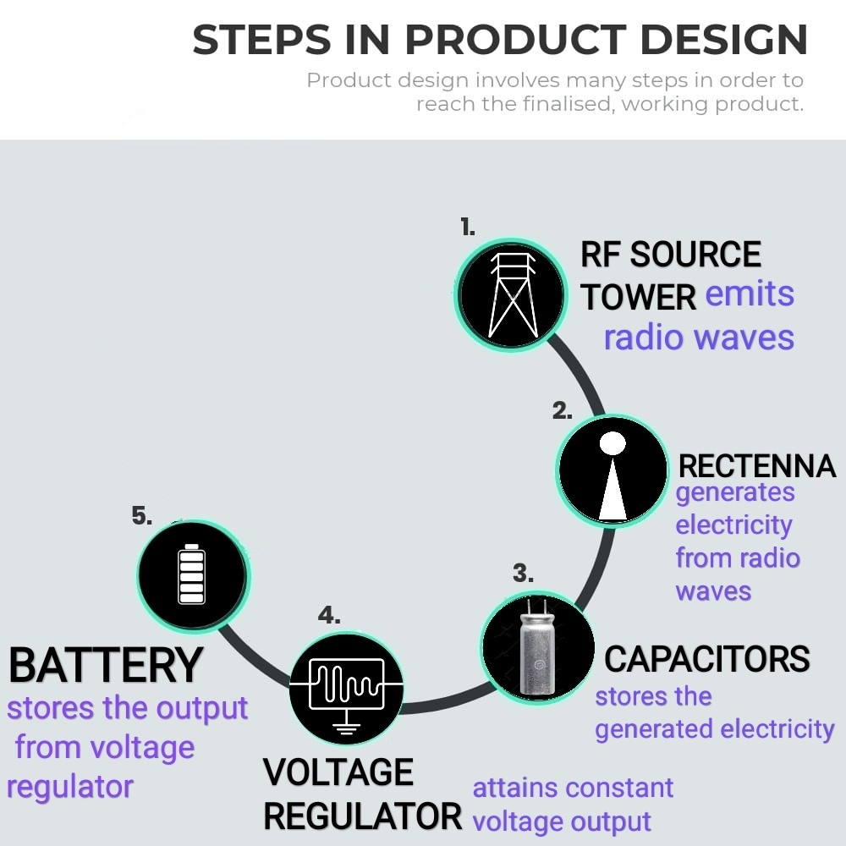
ff

Slide 12
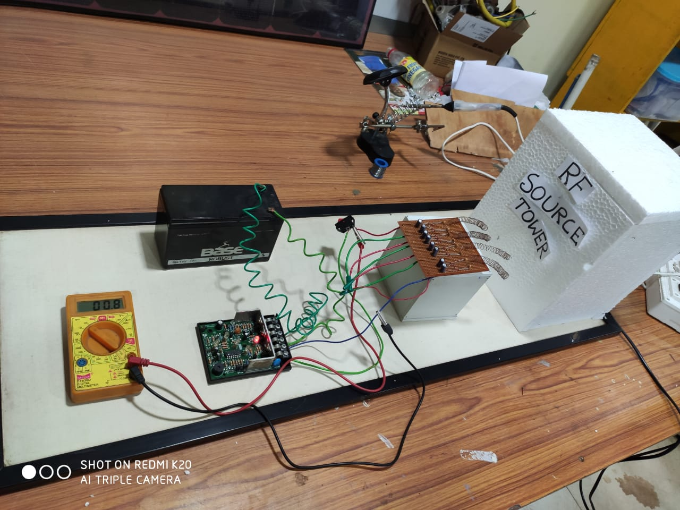
The Prototype
We have designed a rectenna based device which have made it possible and convenient to wirelessly charge multiple electric vehicles all at a time from distance using radio frequency as source.
Battery
Multimeter
Voltage regulator
Rectenna based device

Slide 13
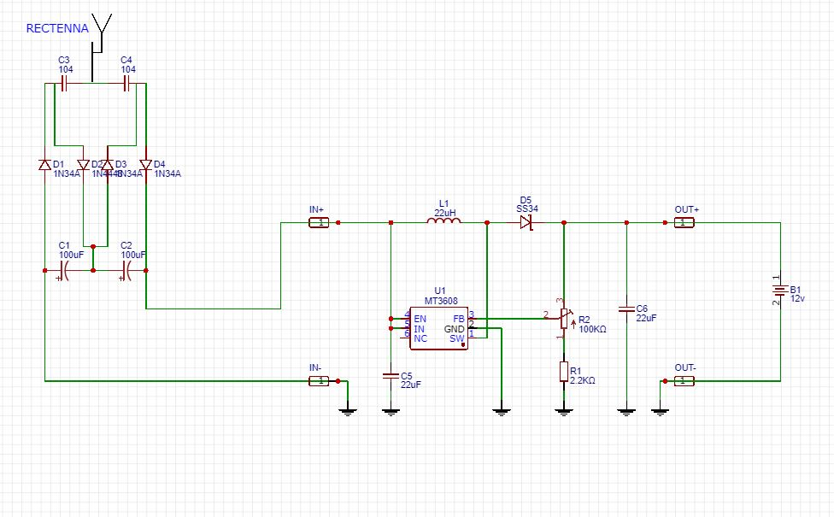

Slide 14
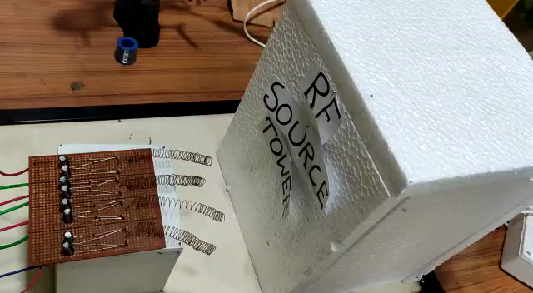
DEMO VIDEO

Slide 15
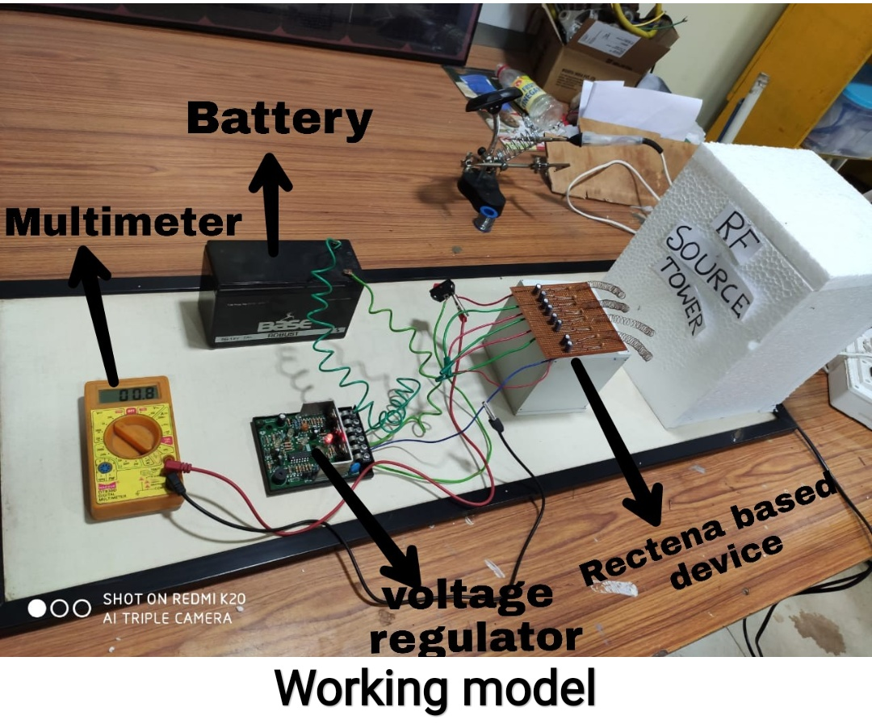
Final Result
1.THROUGH THIS DEVICE THE PROBLEMS OF USING HEAVY WIRES AND ADAPTERS HAS BEEN SOLVED AS THIS DEVICE REQUIRES ONLY RADIO WAVE FREQUENCIES TO CHARGE THE VEHICLES WHICH CAN BE DONE EVEN THROUGH A DISTANCE.
2. ANOTHER PROBLEM WHICH CAN BE SOLVED IS THAT PREVIOUSLY ONLY ONE VEHICLE CAN BE CHARGED AT A TIME BUT THROUGH THIS TECHNOLOGY MULTIPLE ELECTRIC VEHICLES CAN BE CHARGED AT A TIME.

Slide 16
REFERENCES
https://en.wikipedia.org/wiki/Charging_station
https://www.automotive-iq.com/electrics-electronics/articles/innovation-in-electric-vehicle-charging-stations
https://www.mpoweruk.com/infrastructure.htm

